Slide 1
TRANSIENT OF AN ELECTRICAL CIRCUIT.
Whenever the electrical power supplied to a
circuit changes momentarily over a short duration of time, it is called transients
And almost this effect may occur in an electrical
circuit due to capacitive coupling, inductor coupling or conducted noise.
The transient response is the circuit’s temporary response that will die out with time.
The steady-state response is the behavior of the circuit in a long time after an external excitation is applied.

Slide 2
Transients are categorized as either impulse or oscillatory.
Impulse transients-These transients typically have a fast rise time, a fairly rapid decay, and a high energy content,
rising to hundreds and even thousands of
volts. Their duration can be from a few microseconds up to 200 microseconds.

Slide 3
Oscillatory transients-Sometimes called ring wave transients, this type of disturbance has a fast rise time, oscillations that decay exponentially, and lower energy content than impulse transients (250V to 2,500V

Slide 4

Sources of transients.
The Source-Free RC Circuit
A source-free RC circuit occurs when its dc source is suddenly disconnected.
The energy already stored in the capacitor is released to the Resistor.
Consider a series combination of a resistor and an initially charged capacitor, as shown in Fig 01. below.
A source-free RC circuit.

Slide 5
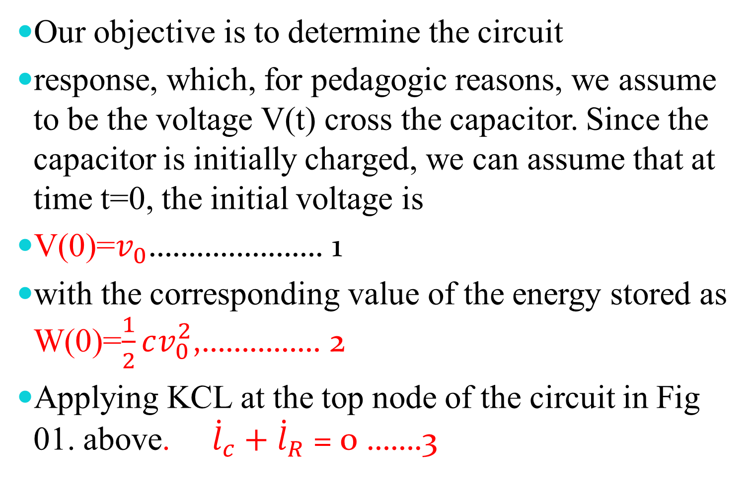
Our objective is to determine the circuit
response, which, for pedagogic reasons, we assume to be the voltage V(t) cross the capacitor. Since the capacitor is initially charged, we can assume that at time t=0, the initial voltage is
V(0)=$v_{0}$…………………. 1
with the corresponding value of the energy stored as W(0)=$\frac{1}{2}cv_{0}^{2}$,…………… 2
Applying KCL at the top node of the circuit in Fig 01. above. ${\dot{l}}_{c}+$ ${\dot{l}}_{R}$ = 0 …….3

Slide 6
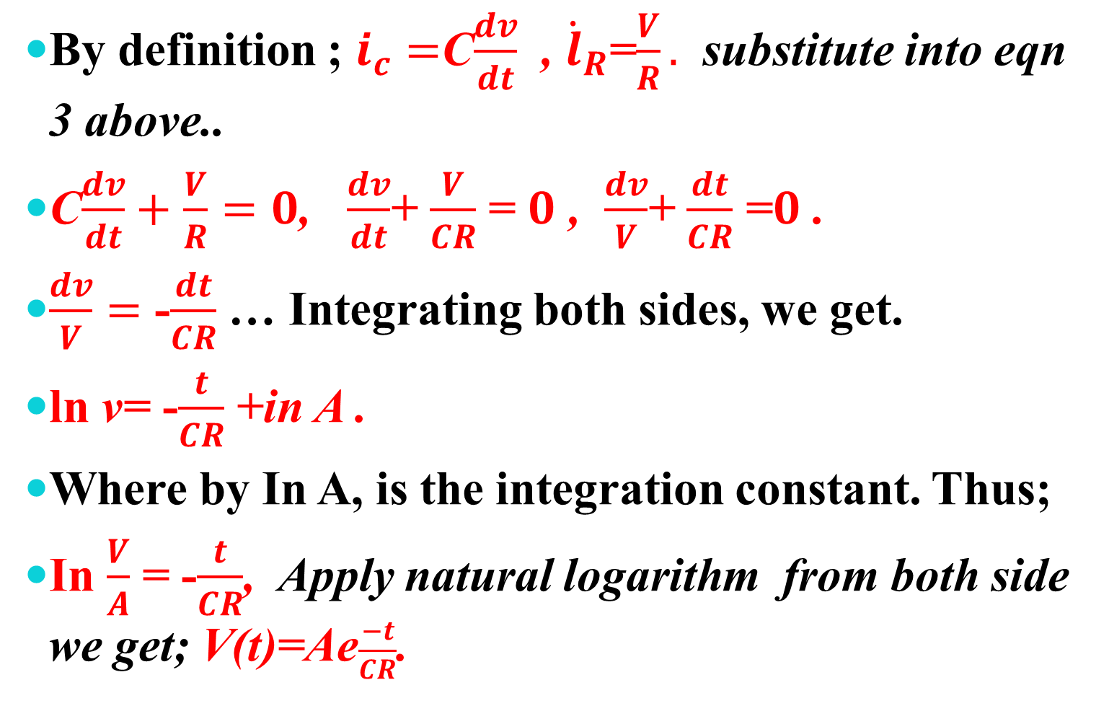
By definition ; $i_{c}=$C$\frac{dv}{dt}$ , ${\dot{l}}_{R}$=$\frac{V}{R}.$ substitute into eqn 3 above..
C$\frac{dv}{dt}+$ $\frac{V}{R}=0$, $\frac{dv}{dt}$+ $\frac{V}{CR}$ = $0$ , $\frac{dv}{V}$+ $\frac{dt}{CR}$ =$0$ .
$\frac{dv}{V}=$ -$\frac{dt}{CR}$ … Integrating both sides, we get.
ln v= -$\frac{t}{CR}$ +in A .
Where by In A, is the integration constant. Thus;
In $\frac{V}{A}$ = -$\frac{t}{CR}$, Apply natural logarithm from both side we get; V(t)=Ae$\frac{−t}{CR}$.

Slide 7
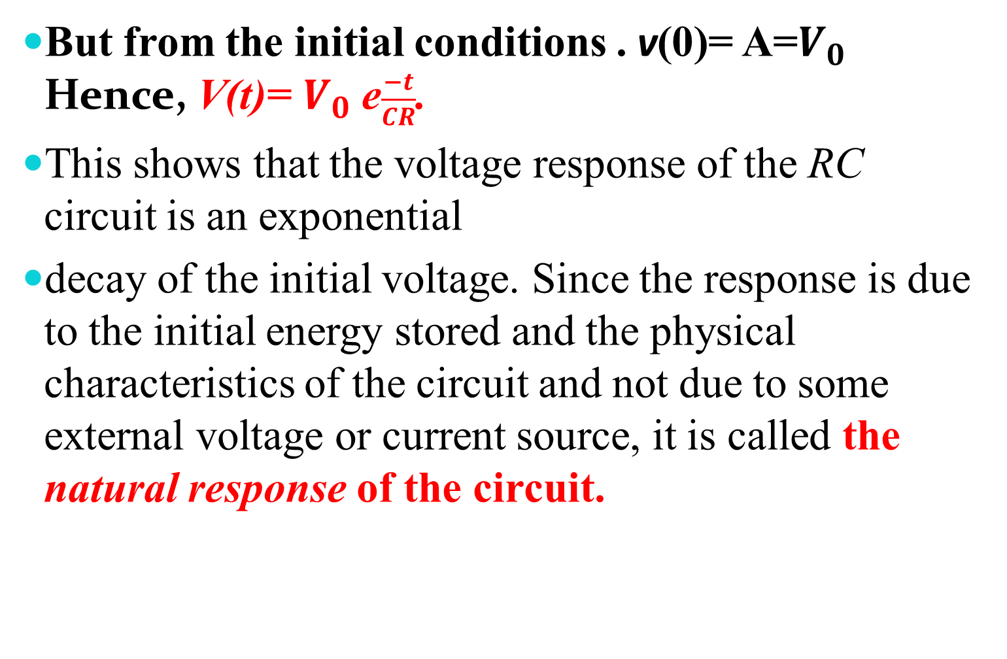
But from the initial conditions . v(0)= A=$V_{0}$ Hence, V(t)= $V_{0}$ e$\frac{−t}{CR}$.
This shows that the voltage response of the RC circuit is an exponential
decay of the initial voltage. Since the response is due to the initial energy stored and the physical characteristics of the circuit and not due to some external voltage or current source, it is called the natural response of the circuit.

Slide 8
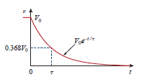
The natural response of a circuit refers to the
behavior (in terms of voltages and currents) .
of the circuit itself, with no external sources of
excitation.
The natural response is illustrated graphically in Fig. below.

Slide 9
Note that at t=0,
we have the correct initial condition as in Eq. 1. As t increases, the voltage decreases toward
zero. The rapidity with which the voltage
decreases is expressed in terms of the time constant.
denoted by ᴦ, the lowercase Greek letter tau.

Slide 10
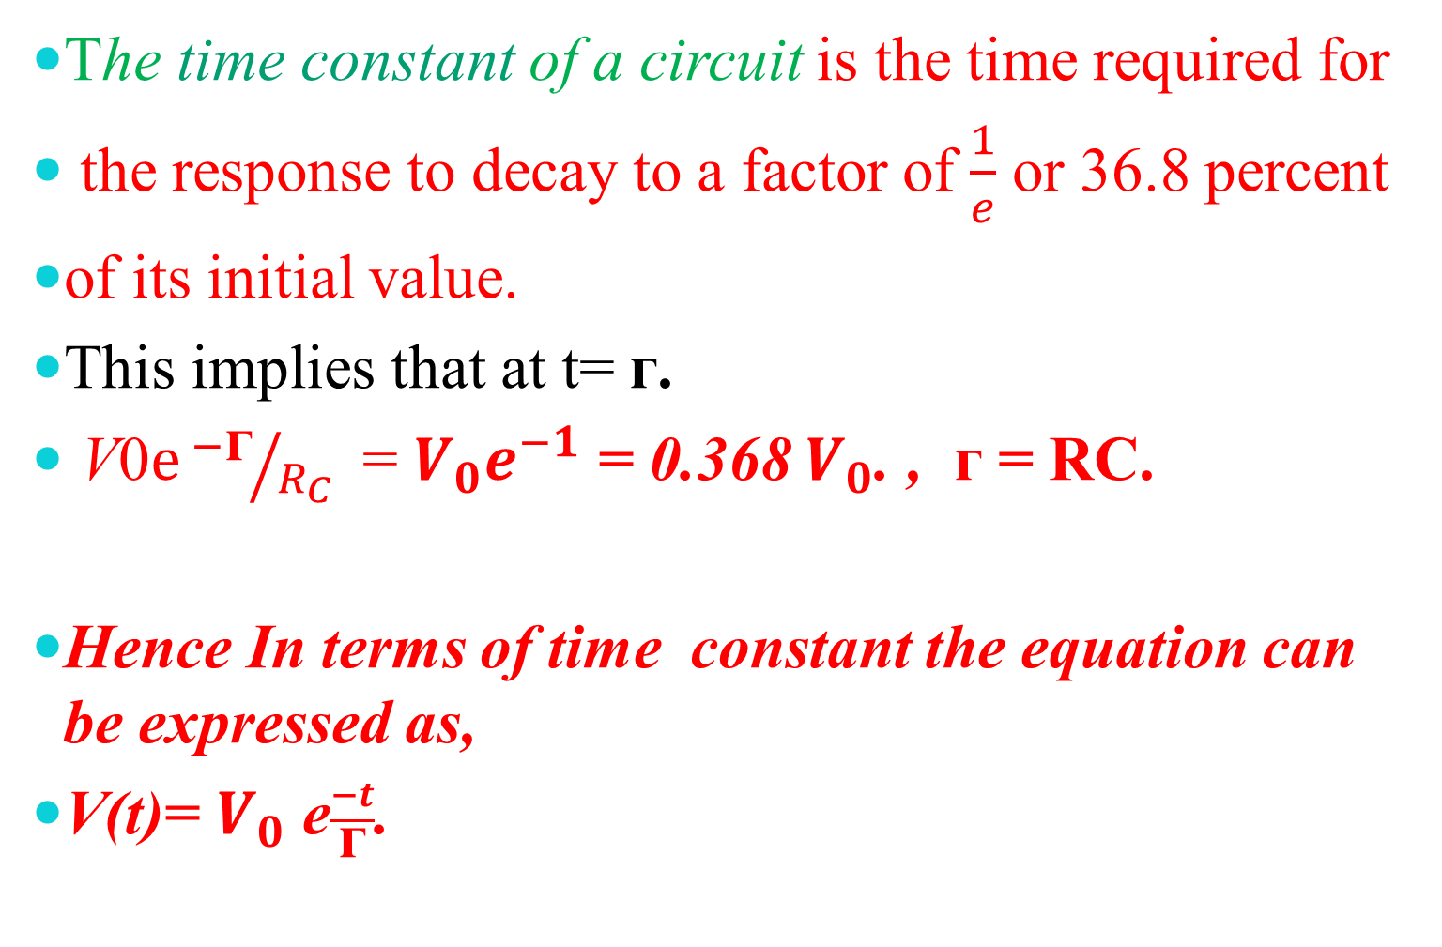
The time constant of a circuit is the time required for
the response to decay to a factor of $\frac{1}{e}$ or 36.8 percent
of its initial value.
This implies that at t= ᴦ.
V0$ⅇ{−\text{ᴦ}}/{R_{C}}$ = $V_{0}e^{−1}$ = 0.368 $V_{0}$. , ᴦ = RC.
Hence In terms of time constant the equation can be expressed as,
V(t)= $V_{0}$ e$\frac{−t}{\text{ᴦ}}$.

Slide 11



Examples.
1.From the circuit below Let Vc(0)= 30v, Find Vc, Vx, $i_{x}$. for t≥0.
2.Let Vc(0)= 45v, obtain Vc, Vx, $i_{0}$for t≥0.

Slide 12
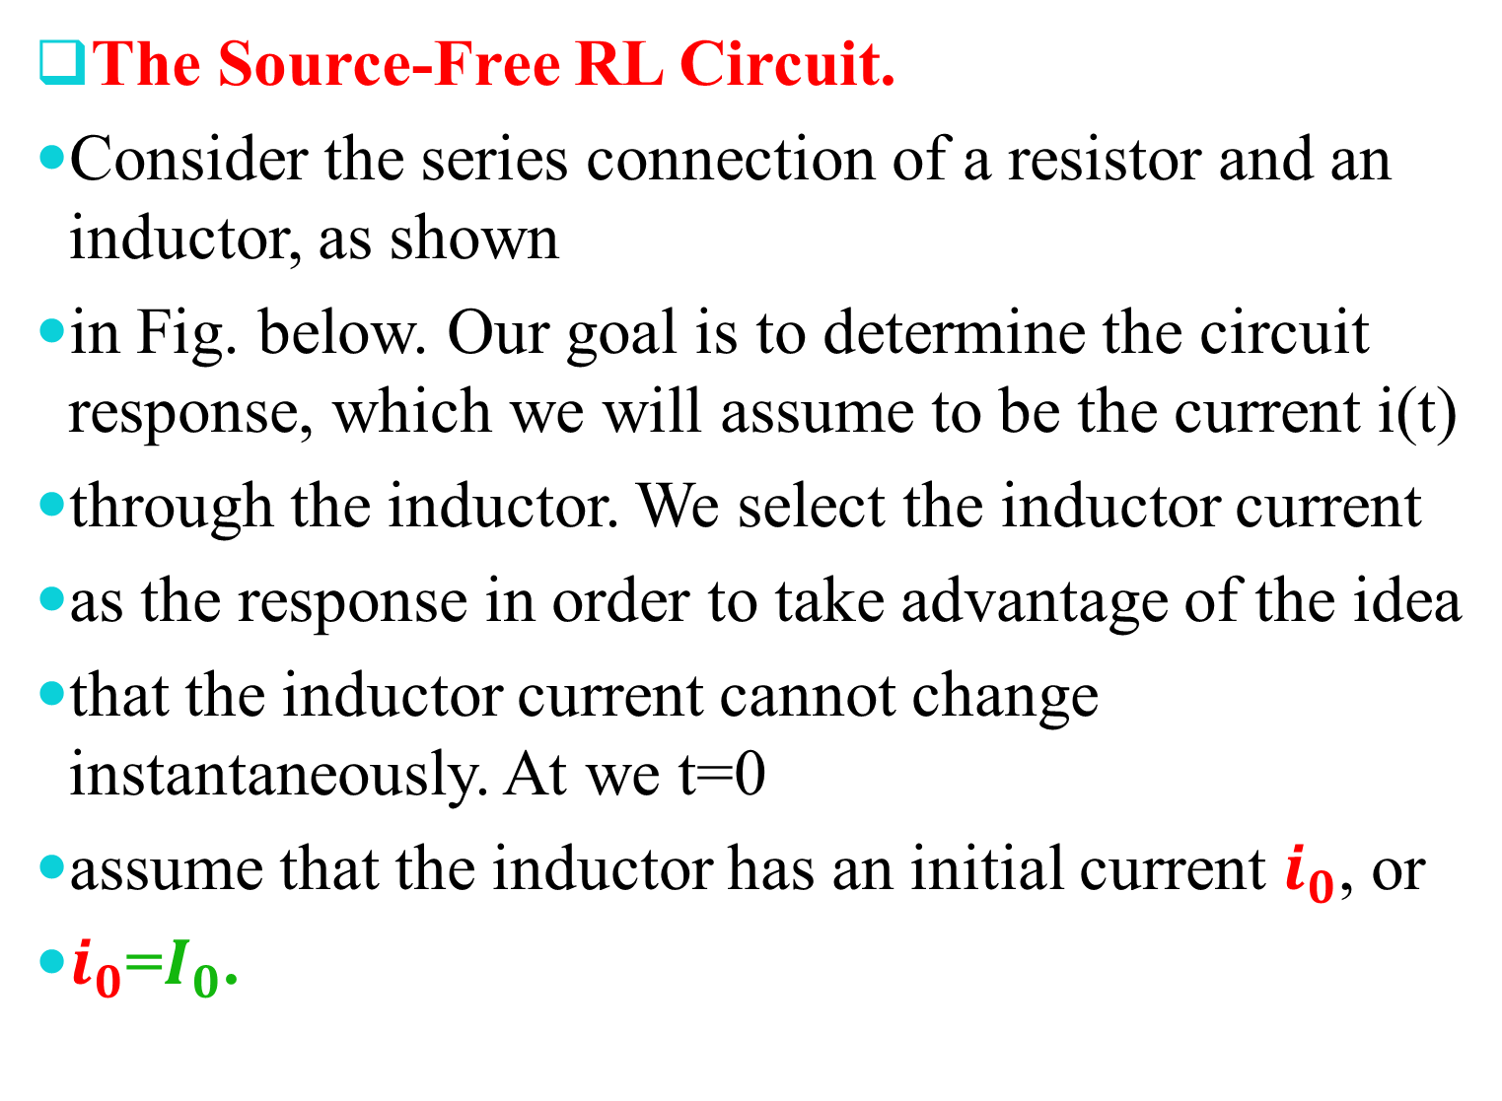
The Source-Free RL Circuit.
Consider the series connection of a resistor and an inductor, as shown
in Fig. below. Our goal is to determine the circuit response, which we will assume to be the current i(t)
through the inductor. We select the inductor current
as the response in order to take advantage of the idea
that the inductor current cannot change instantaneously. At we t=0
assume that the inductor has an initial current $i_{0}$, or
$i_{0}$=$I_{0}$.

Slide 13
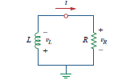
A source-free RL circuit
.
with the corresponding energy stored in the inductor as;

Slide 14
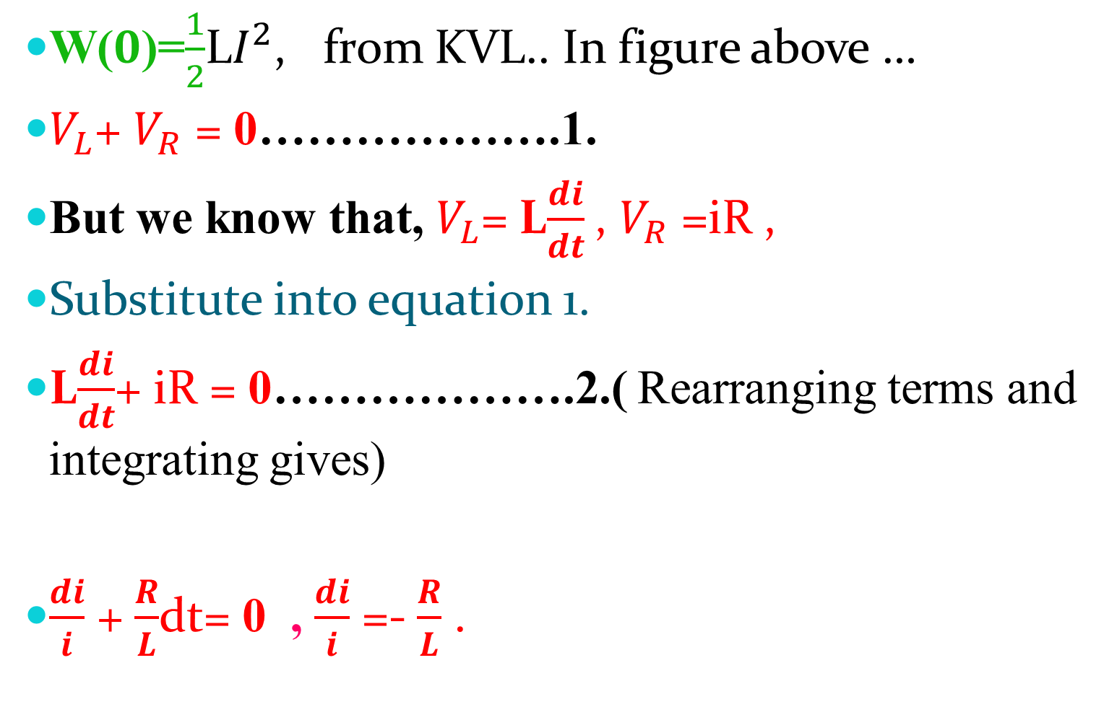
W($0$)=$\frac{1}{2}$L$I^{2}$, from KVL.. In figure above …
$V_{L}$+ $V_{R}$ = 0……………….1.
But we know that, $V_{L}$= L$\frac{di}{dt}$, $V_{R}$ =iR ,
Substitute into equation 1.
L$\frac{di}{dt}$+ iR = 0……………….2.( Rearranging terms and integrating gives)
$\frac{di}{i}$ + $\frac{R}{L}$dt= 0 , $\frac{di}{i}$ =- $\frac{R}{L}$ .

Slide 15
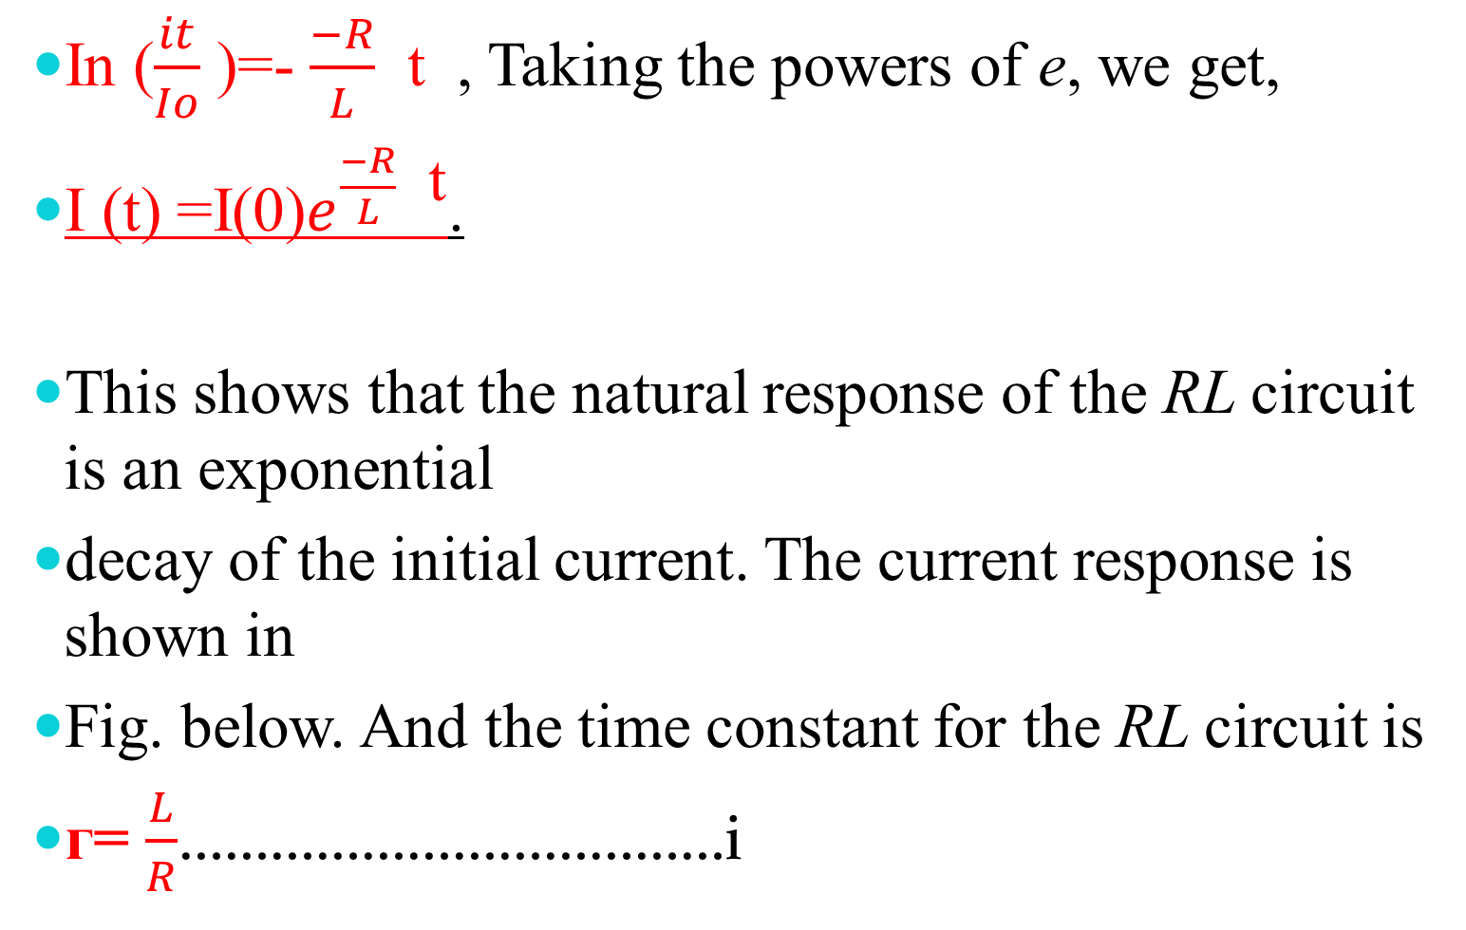
In ($\frac{it}{Io}$ )=- $\frac{−R}{L}$ t , Taking the powers of e, we get,
I (t) =I(0)$e^{\frac{−R}{L} \text{t}}$.
This shows that the natural response of the RL circuit is an exponential
decay of the initial current. The current response is shown in
Fig. below. And the time constant for the RL circuit is
ᴦ= $\frac{L}{R}$………………………………i

Slide 16
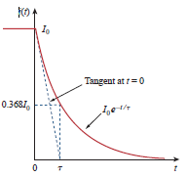

I (t) =I(0) $e^{\frac{−t}{\text{ᴦ}} }$…………ii
With the current in Eq. ii, we can find the voltage across the
resistor as;
vR(t)= I (t) R= RI(0) $e^{\frac{−t}{\text{ᴦ}} }$

Slide 17
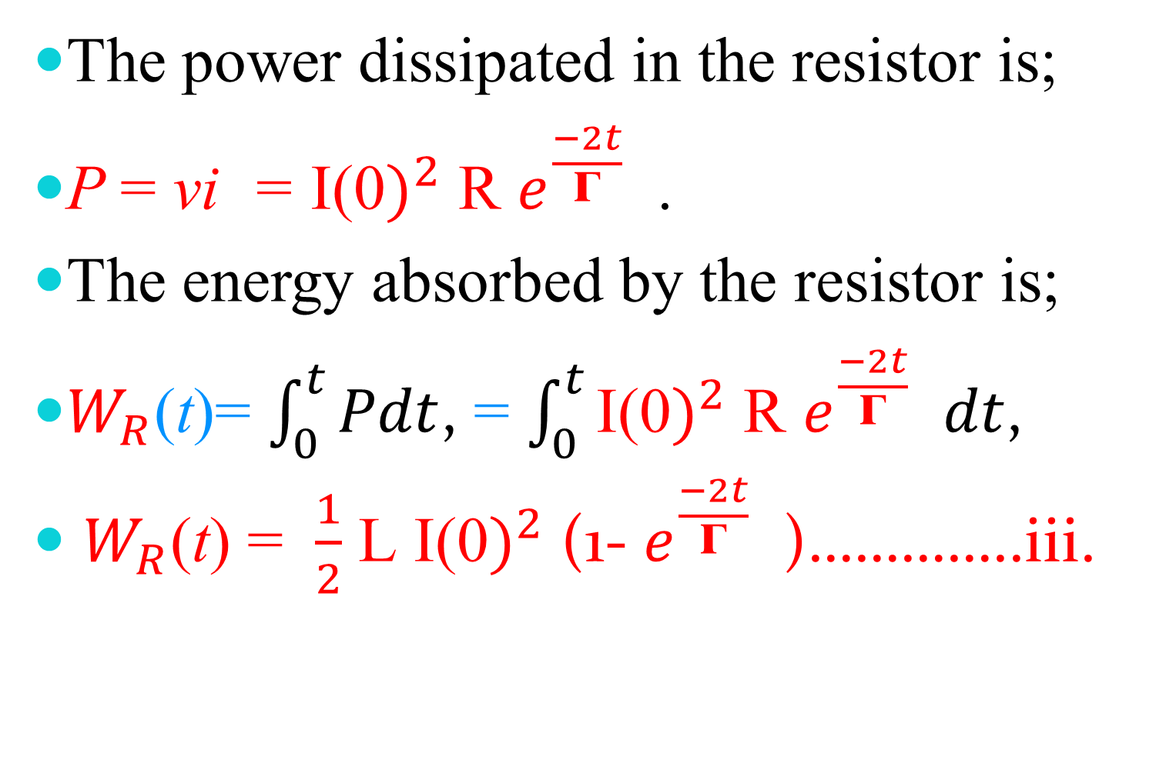
The power dissipated in the resistor is;
P = vi = ${\text{I}\text{(0})}^{2}$ R $e^{\frac{−2t}{\text{ᴦ}} }$.
The energy absorbed by the resistor is;
$W_{R}$(t)= $\int_{0}^{t}{Pdt}$, = $\int_{0}^{t}{{\text{I}\text{(0})}^{2} \text{R} e^{\frac{−2t}{\text{ᴦ}} }dt}$,
$W_{R}$(t) = $\frac{1}{2}$ L ${\text{I}\text{(0})}^{2}$(1- $e^{\frac{−2t}{\text{ᴦ}} }$)…………..iii.

Slide 18
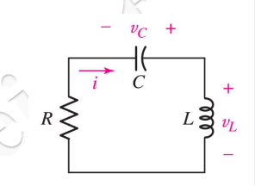
The Source-Free Series RLC Circuit.
The circuit shown on Figure 1 is called the series
RLC circuit. We will analyze this circuit in order to
determine its transient characteristics equation.

Slide 19
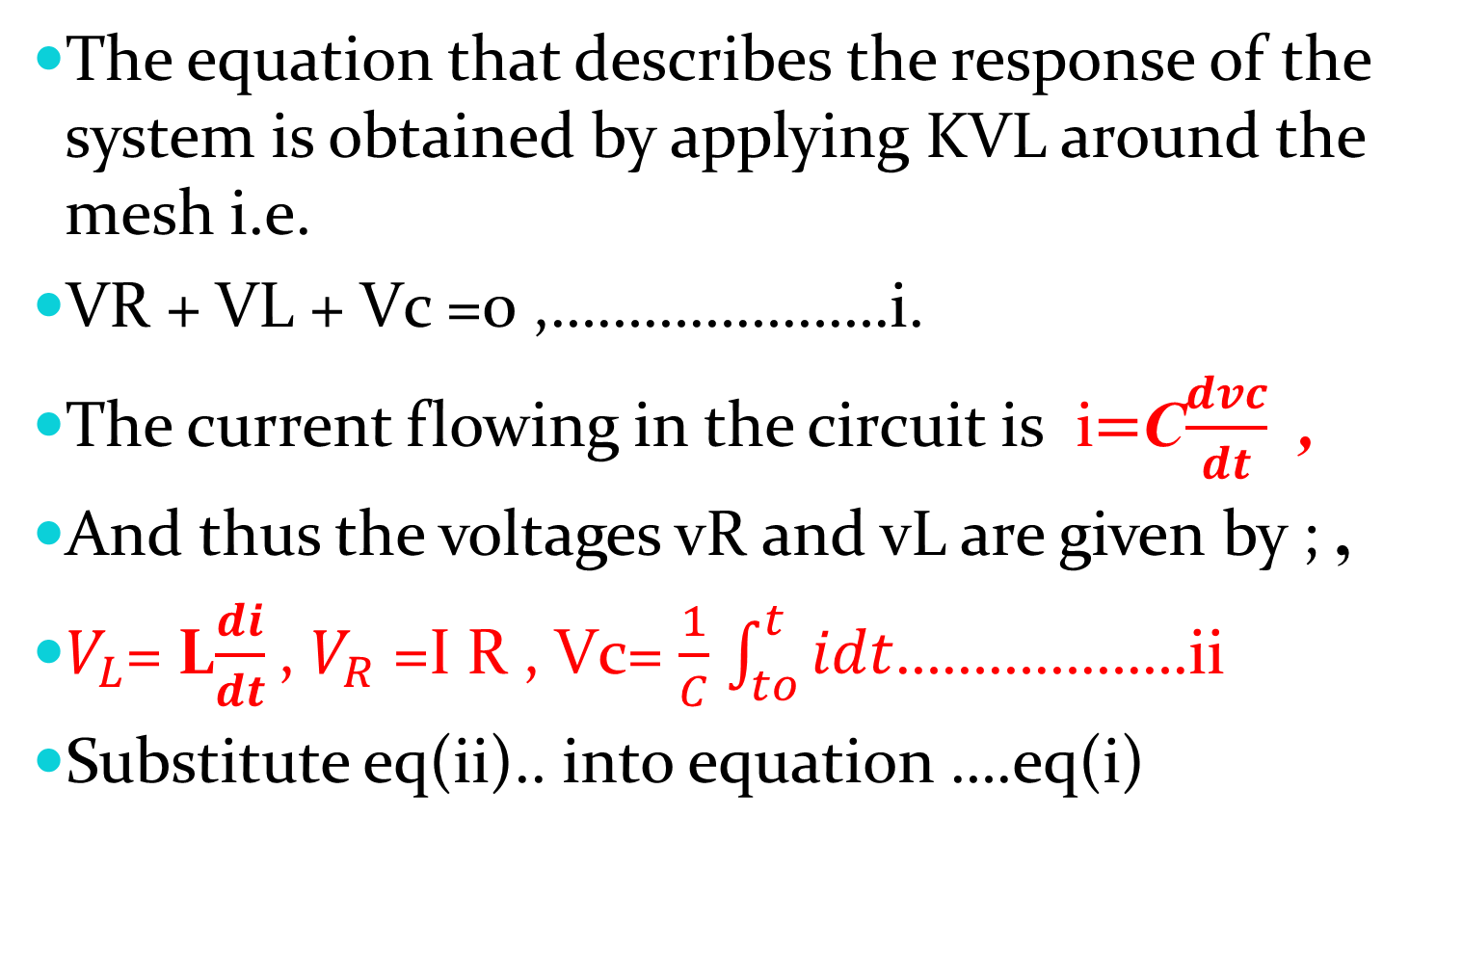
The equation that describes the response of the system is obtained by applying KVL around the mesh i.e.
VR + VL + Vc =0 ,………………….i.
The current flowing in the circuit is i$=$C$\frac{dvc}{dt}$ ,
And thus the voltages vR and vL are given by ; ,
$V_{L}$= L$\frac{di}{dt}$, $V_{R}$ =I R , Vc= $\frac{1}{C}$ $\int_{to}^{t}{idt}$……………….ii
Substitute eq(ii).. into equation ….eq(i)

Slide 20
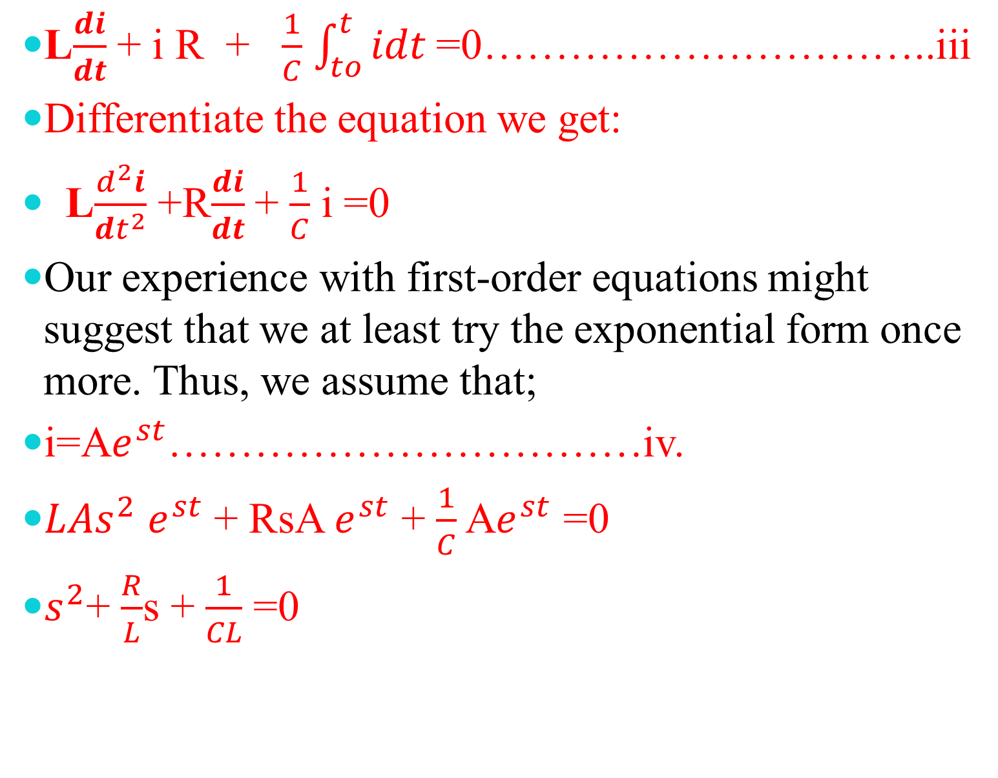
L$\frac{di}{dt}$ + i R + $\frac{1}{C}$ $\int_{to}^{t}{idt}$=0…………………………..iii
Differentiate the equation we get:
L$\frac{d^{2}i}{dt^{2}}$ +R$\frac{di}{dt}$ + $\frac{1}{C}$ i =0
Our experience with first-order equations might suggest that we at least try the exponential form once more. Thus, we assume that;
i=A$e^{st}$……………………………iv.
$LAs^{2}$ $e^{st}$ + RsA $e^{st}$ + $\frac{1}{C}$ A$e^{st}$ =0
$s^{2}$+ $\frac{R}{L}$s + $\frac{1}{CL}$ =0

Slide 21

From,
S= $\frac{−b±\sqrt{b^{2}−4ac}}{2a}$
S= $\frac{−R}{2L}+\sqrt{{(\frac{R}{2L})}^{2}−\frac{1}{LC}}$ Or
S= $\frac{−R}{2L}−\sqrt{{(\frac{R}{2L})}^{2}−\frac{1}{LC}}$ Where by,
W0=$\sqrt{\frac{1}{LC}}$ , ᾳ= $\frac{R}{2L}$ ,

Slide 22
The roots s1 and s2 are called natural frequencies, measured in nepers per second (Np/s), because they are associated with the natural response of the circuit;
ωo is known as the resonant frequency or strictly as the undamped natural frequency, expressed in radians per second (rad/s); and
α is the neper frequency or the damping factor, expressed in nepers per second.

Slide 23
From the roots s1 and s2 we can infer that there are three types of solutions .
Overdamped Case…………..ᾳ>wo.
Underdamped Case…………. ᾳ<wo.
Critically damped Case………. ᾳ=wo.

Slide 24
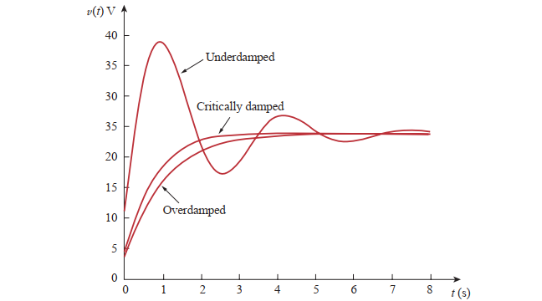
Response for three degrees of damping.

Slide 25
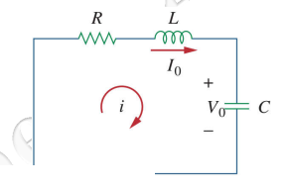
Example:
for the circuit in shown figure, if R=40Ω, L=4H, and C=1/4F, Calculate the characteristic roots of the circuit. Is the natural response overdamped, underdamped, or critically damped?

Slide 26
FILTER CIRCUIT.
What is the Filter ?
A filter is a circuit that is designed to pass signals with desired frequencies and reject or attenuate other signals.
As a frequency-selective device, a filter can be used to limit the frequency spectrum of a signal to some specified band of frequencies.
Filters are the circuits used in radio and TV receivers to allow us to select one desired signal out of a multitude of broadcast signals in the environment.

Slide 27
Any Filter Circuit can be classified as ;
(i ) Passive Filter (ii) Active Filter .
A filter is a passive filter if it consists of only passive elements R, L, and C. And,
It is said to be an active filter if it consists of active elements (such as transistors and Opamps in addition to passive elements R, L, and C

Slide 28
There are four types of filters whether passive or Active. Which are;
1. A low pass filter passes low frequencies and stops high frequencies,
2. A high pass filter passes high frequencies and rejects low frequencies,
3. A band pass filter passes frequencies within a frequency band and blocks or attenuates frequencies outside the band,
4. A band stop filter passes frequencies outside a frequency band and blocks or attenuates frequencies within the band, as shown ideally

Slide 29
………………THE END OF LECTURE FOUR………..
THANK you!!!!!!!!!!!

